Slide 1


Overview of business canvas model for planning and sustaining RDM services
Joy Davidson
Digital Curation Centre
Notes:
Use an established approach to guide you through the process of developing a business model.
BCM is a strategic planning template. It is widely used and can provide you with the building blocks for developing a business model.
The business model canvas is a visual tool for strategic planning and therefore does not require in detailed knowledge of all cost items, but insightful estimates for expenses. This improves the usability beyond the domain of cost model specialists and allows a high-level view of the digital curation services and solutions.
The ease of use of a Business Model Canvas (BMC) template and the visual representation of essential building blocks makes it suitable for strategic discussions of digital curation business models. A BMC provides an effective approach to identify and meet supply and demand side requirements through associating the identified customer segments with appropriate value propositions.
How is it used?
Wikipedia: The Business Model Canvas can be printed out on a large surface so groups of people can jointly start sketching and discussing business model elements with post-it note notes or board markers. It is a hands-on

Slide 2
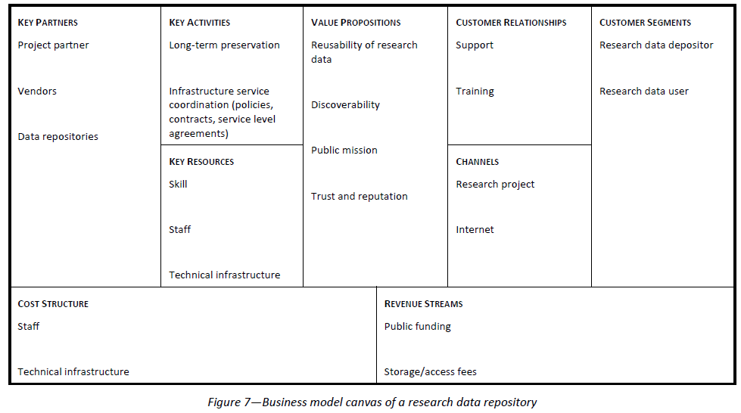
BCM for Research Data Repository
Notes:
For the next 20 minutes or so, we’ll run through the sections of a BCM template using a worked example for a research data repository.

Slide 3
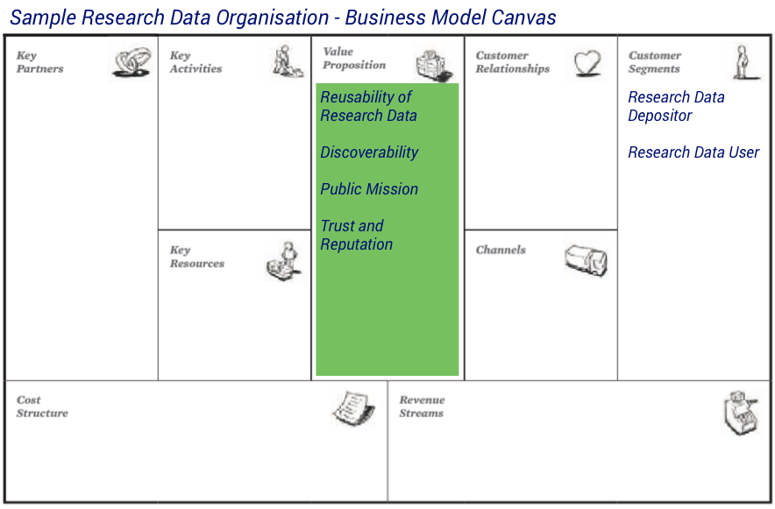
Identify the value proposition
Notes:
The central building block of the canvas is the value proposition. It can be seen as the qualities of the product that are offered to the customers considered in the business model. It describes the key reasons why customers use a specific product or a service of a business. A value proposition aims at solving the problems or needs of the customers, and therefore is seen by them as something that provides an additional value.
Questions to consider - why do these customers choose to make use of the services offered by this specific organisation? In essence, we are looking for the key reasons why customers use the specific products/service offered by this organisation over its competitors. These are the value propositions, and they form the central building block of any business model canvas.
Example: Typical value propositions for an organisation such as our RDO include increased discoverability of research data, reusability of research data, and the public mission. Data needs to be discoverable in order to be reused, so issues such as data management, support for data producers, data archiving and documentation need to be addressed. Reusability produces new opportunities for innovation and for new data users, whilst reducing the costs of duplicated research effort. Research results often originate from publicly funded projects, and research data repositories can serve the public mission in several ways. The value may also be for improvied transparency and evidence of compliance with funder’s mandates.
Important to note here that the value propositions may be multiple and targeted to particular customers.

Slide 4
Drivers
Efficiency
Reputation
Trust
Confidentiality
Transparency
Interoperability
Notes:
Remember to consider drivers for your organisation in determining your value proposition. For instance, many funder sponsored and/or national data centres are keen to establish themselves as trusted digital repositories. In the case of institutional data repositories, the drivers may be more aligned with transparency and compliance with external mandates such as EPSRC.

Slide 5
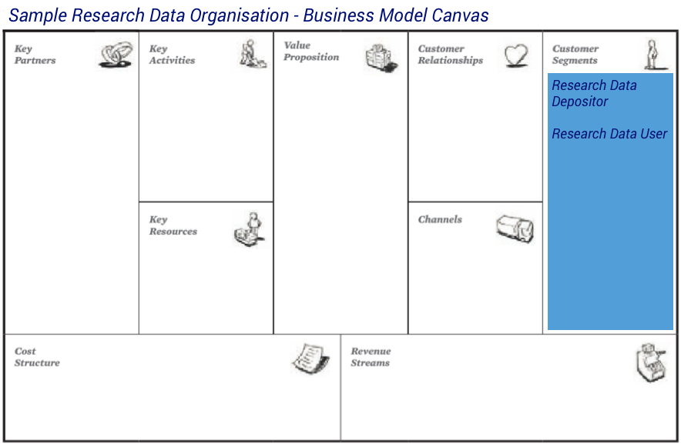
Identify the range of customers
Notes:
The customers of a business model are listed in the customer segments building block. Here they are divided into separate segments if they have different requirements and if they need to be addressed with a separate offer. Customers are also grouped in separate segments based upon on whether a different channel is used for product distribution or service provision. Other reasons to define a separate customer segment are different types of relationships, profitability and customer interests in different aspects of the offer.
Example: For our sample research data repository, there are basically two customer segments, those who want to deposit their research data and the ones who want to access and use deposited research data. The latter may include researchers looking to build upon existing work or it could be the HEI wanting to check compliance with funders mandates (e.g., has data been deposited as required at the end of the projects? REF2020?). It may also be something that the funder wishes to be able to confirm.

Slide 6
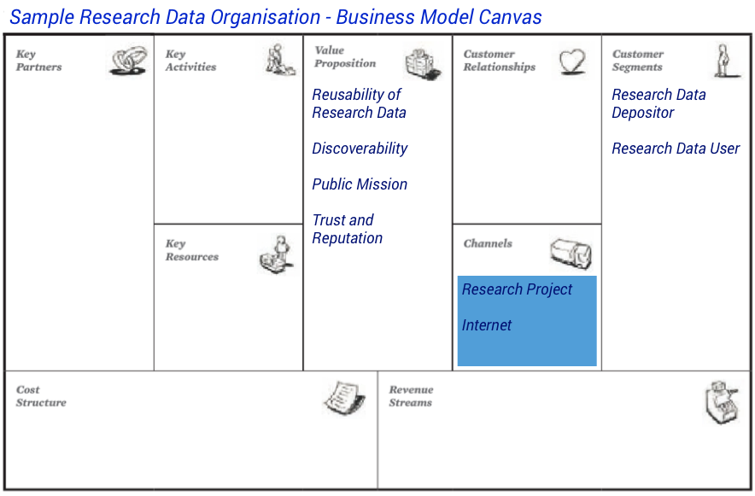
Identify the distribution channels
Notes:
The channels of a business model canvas describe the interface of a company to its customers. Through this interface a company can raise awareness about its offers, let customers evaluate the company’s value propositions, and make use of the services. It also describes the distribution channels and support activities.
Consider - which channels are used to communicate to customers? Consider not only the channels through which an organisation sells/delivers its services and products, but also the channels used to promote values and raise awareness.
In our example, the research data repository provides an web interface to its holdings to enable simple access for its customer segments. The repository will also have ongoing communications with content creators who will be depositing their data. These might include for example individual face-to-face contact, support via telephone, online training material and manuals and workshops and courses promoting sustainable data archiving and reuse of data.
Remember to consider your customers here – you should have some channel for reaching each customer you have identified. Remember too that the messages may need to be tailored to reflect the value propositions you have identified for each customer – there may be more than one!

Slide 7
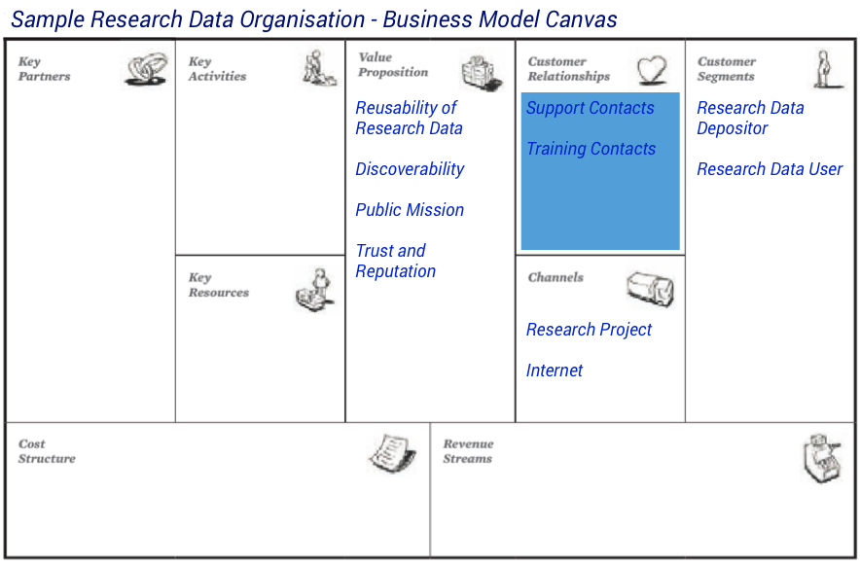
Identify the customer relationships
Notes:
The customer relationship building block consists of the relations of the company to its customer segments. Relationships are used to acquire new customers and to keep in touch with current customers. They can be personal (where customers interact with real humans), or automated (where customers are using services that do not need direct human interactions).
The next question is - how do customers interact with the organisation? Consider not only personal contacts where customers interact with real humans, but also automated contacts where customers are using services that do not need direct human interaction. Consider, too, interactions across the product lifespan from initial contact with new customers, through to ongoing interaction with existing customers. List these on the business model canvas.
Example: Our RDO offers individual face-to-face contact and telephone support for research data users. Training is also provided to these users via online training material, online manuals, and presenter-delivered courses in order to promote sustainable data archiving and data reuse. Support and training is also offered to research data depositors via the same range of interactions to ensure any data being considered for deposit complies with the applicable technical, legal and descriptive (metadata) requirements.

Slide 8
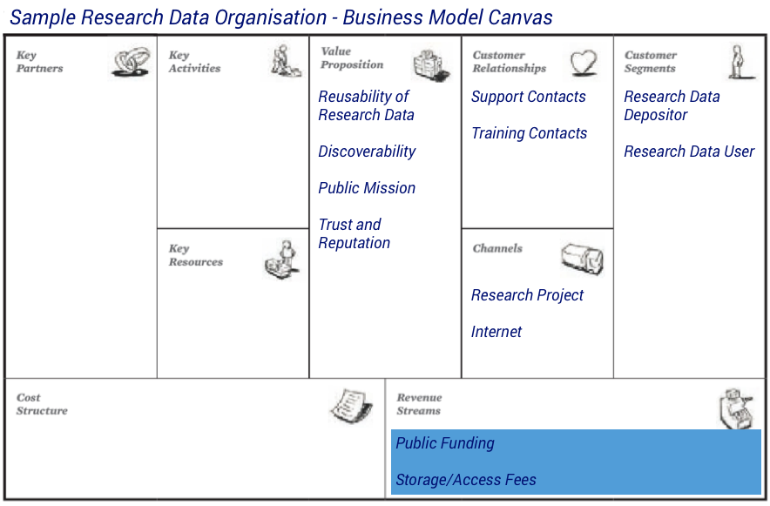
Identify the revenue streams
Notes:
The revenue streams represent the flow of payments to a company. A successful business model needs to understand for which value proposition its customers are willing to pay. Revenue streams can be one-time payments or periodical payments. There are many different mechanisms to generate revenues.
Revenue streams describe the flow of payments into the organisation - these can be one-time payments or periodical payments. A successful business needs to identify for which value propositions its customers are willing to pay. Use the business model canvas to assess this by linking the revenue streams you identify to both the customers segments and the value propositions already listed on the canvas. Add this to the canvas to complete the customer perspective.
Public funding forms one revenue stream for our RDO, and this ensures that the expenses for operating and maintaining the repositories are covered. Additional fees could be charged for both data depositors and data users, and allocated for further development of the repository services catering to both customer segments.

Slide 9
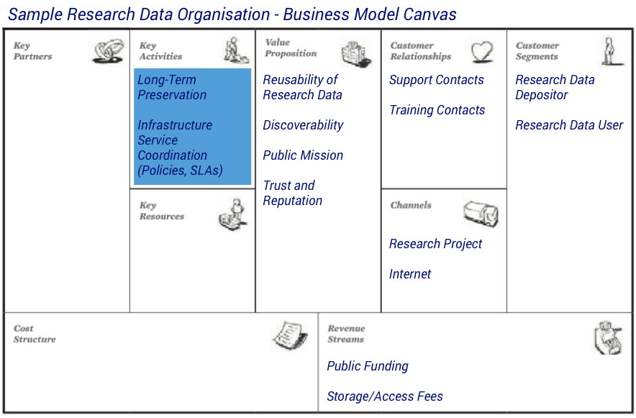
Identify the key activities
Notes:
The key activities are those that are required to enable a value proposition and make use of the key resources in order to offer them to customers. These activities can be to produce a physical asset, which is typical for manufacturing business models. They can also be problem solving, which is often the case if a company is offering a service as a value proposition. Consulting and training activities are common key activities in these cases. The third type of key activities are platforms to enable a value proposition. For example, the way credit card companies require activities related to their transaction platform connecting merchants, customers and banks.
To model the activity perspective, start with the question - what activities does the organisation need to do in order to deliver products and services to its customers? In terms of our business model, activities enable the value propositions to be delivered by putting the rest of the organisation to work. Look out for different types of activity. In production environments, activities may generate physical products; in service environments, activities may include training, consultancy and problem-solving. Add these to the business model canvas.
Example: The key activities performed by our RDO comprise long-term preservation activities, and the coordination of infrastructure services such as policies, contracts, and service-level agreements (SLAs).

Slide 10
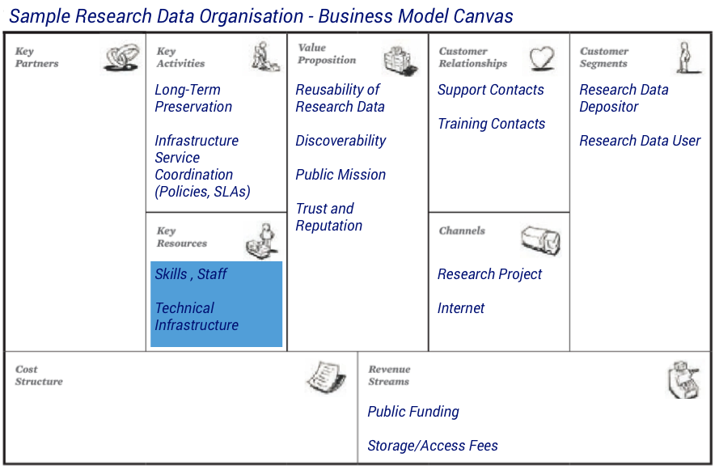
Identify the key resources
Notes:
The building block key resources deals with resources that are required to offer a certain value proposition. Key resources can be physical (such as buildings or machines), intellectual (such as patents or partnerships), human (such as researchers or software developer), or financial (such as a budget large enough to conduct long-term studies for pharmaceutical research and development).
The next question is - what assets need to be in place within the organisation in order to perform these activities? Look out for different types of resource such as physical, intellectual, staff and financial assets. Example physical assets might include buildings and equipment. Example intellectual assets might include patents or partnerships. Example staff assets might include staff with specialist skills such as researchers and software developers. Example financial assets might include sufficient budget to support long-term longitudinal studies such as clinical trials.
Example: Key staff assets required to support the activities of our RDO are the specialist skills of archivists and librarians. A key physical asset is the technical infrastructure that enables the repository to offer its services.

Slide 11
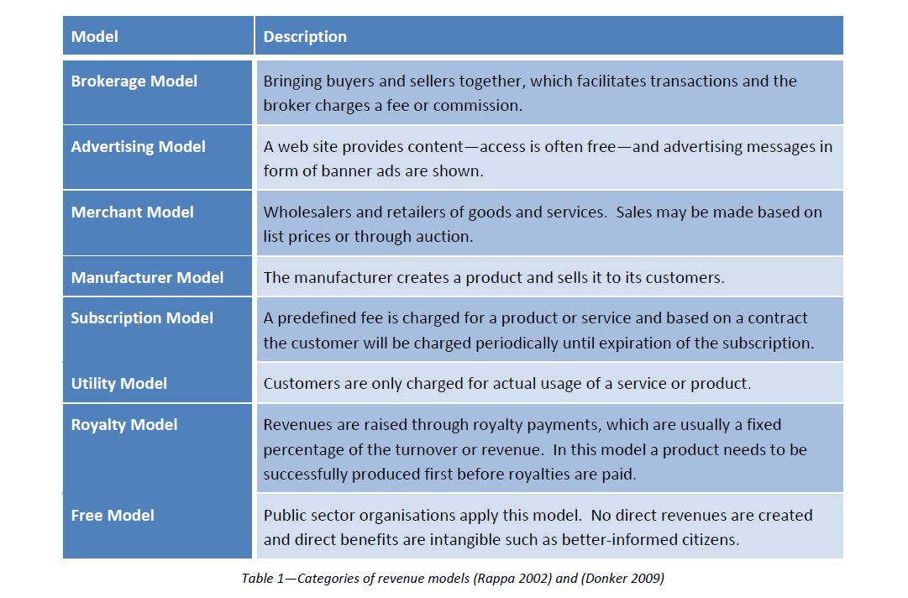
Revenue Models
Notes:
A revenue model describes how a business can create revenue streams and is an essential part of a business model.
The subscription model is often based on a contract where the users gains access to a service or product and agrees to pay predefined periodic fees. The advantage for the company is the security of regular revenue streams, which are raised in advance. Users benefit from this model because the costs are known in advance.
The utility model is also known as the pay as you go model. Customers only have to pay for the actual usage, which can be based on time, data volume, or any other measurement suitable for the offer. The advantage for the customers is that they only pay for actual usage. The disadvantage for the companies is that they need a mechanism to deal with small payments and that is only suitable if the access is more important than the possession.
The royalty model can be applied on successfully developed products. The revenues are based results because the price is a fixed percentage of the turnover or revenue of the user’s product. The advantage of this model is that royalties can be paid after the success of the user’s product, which leaves enough room to experiment. If the user’s product becomes a success there is a regular revenue stream from royalties. The main disadvantage is that the company has no certainty that any income will be generated at all (for example if the user’s product is not selling well).
The free model is often employed by public sector organisations fulfilling a public mission as service providers for citizens. There are no direct revenues, but indirect financial benefits may be created in the long term if value added products are created by earlier access or usage of a free public good, thus creating additional tax revenue at a later time.

Slide 12
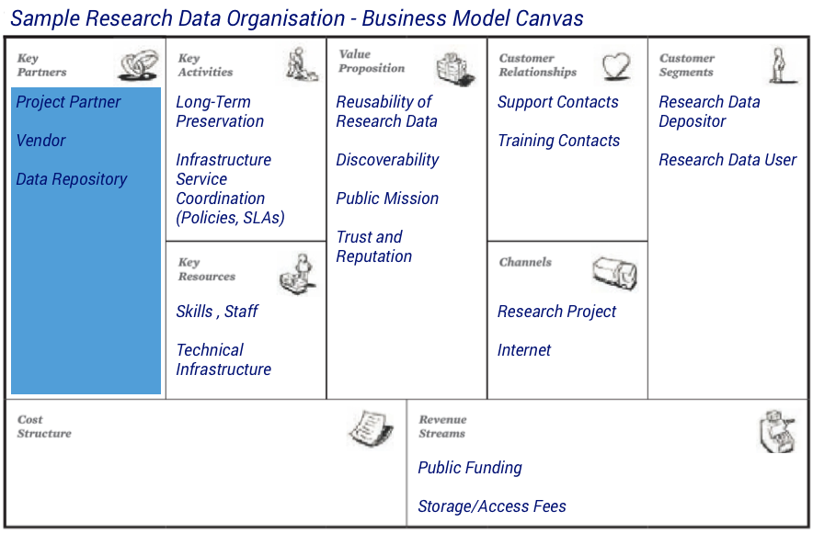
Identify the key partnerships
Notes:
There are three basic motivations for creating key partnerships. The first reason is that a business model requires a specific activity that cannot be performed by the company on its own, when a key resource is missing or not sufficiently available—such as specialised knowledge or a technical infrastructure. Another motivation is the economy of scale to reduce costs and to optimize the use of resources. Sharing infrastructure and outsourcing are effects of these optimising partnerships. The third reason is risk reduction and reduction of uncertainties where partnerships are formed even between market competitors to collaborate and develop new offers. The high financial risk is shared among the partners, and they create new potential products or services such as large software solutions or new standards.
Consdier - are there any gaps in organisational capabilities that limit the ability to deliver the value proposition? Gaps, in this sense, could be a lack of resource or an inability to perform certain activities. If so, look at the potential to strike partnerships that can fill these gaps. Another possible motivation for striking partnerships is achieving economy of scale in order to reduce costs and optimise resource use. Possible impacts of these optimising partnerships include sharing infrastructure and outsourcing services.
Example: Repositories can collaborate within research projects and therefore universities and other research organisations are often key partners. Additional key partners are third party vendors who provide commercial solutions for the keys activities, for example, outsourced curation activities like digitisation. They can also provide support for the key resources, for example, consulting services for certification of digital repositories or outsourced technical infrastructure such as storage. A third group of key partners are the other research data repositories, which can share parts of the infrastructure and which can exchange knowledge and provide access to a wider selection of digital asset.

Slide 13
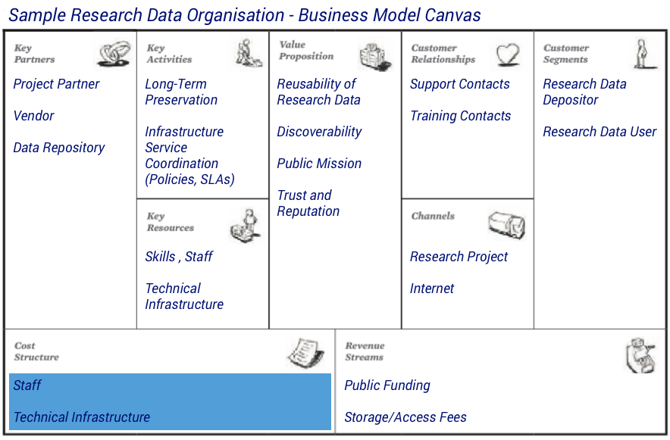
Identify the cost structure
Notes:
The cost structure lists the most significant cost elements of a business model. This could be the most expensive key activities or key resources. A more detailed evaluation of costs structures is best undertaken using cost models as this is not the aim of this business model canvas.
Cost structure examines how the key activities drive the costs being incurred by the organisation, and importantly whether these costs align with the value proposition. Keep in mind that costs may be fixed or may be scalable. Check out whether any major costs do align with the key activities and/or the value proposition for the organisation. List the most significant cost elements of the business model on the canvas to complete the activity perspective.
Example:The revenue stream is generally mainly through public funding and can be extended with usage fees, such as depositing fees in relation to the volume of curated research data or fees for accessing deposited data. As part of the public mission most repositories are keen to enable access for a large user community and would not like to restrict the access by introducing fees for accessing and using the deposited research data.

Slide 14
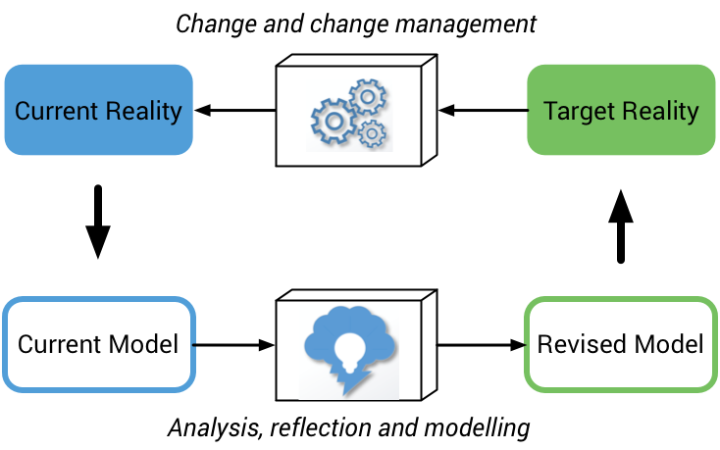
Sustainability of your business model
Notes:
Keep in mind that the business model you use now is unlikely to remain a perfect fit for your organisation over the longer term. Changes in legislation, evolving stakeholder needs, and potential new revenue streams necessitate the ongoing evaluation and refinement of your business model to ensure that your operations remain viable over time.
It is important to set aside time and effort to actively monitor your business model. By doing so you put yourself in a better position both to respond in a more agile manner to evolving organisational context and stakeholder needs, and to reassess how you deliver services and activities in the face of evolving resources and cost drivers.

Slide 15
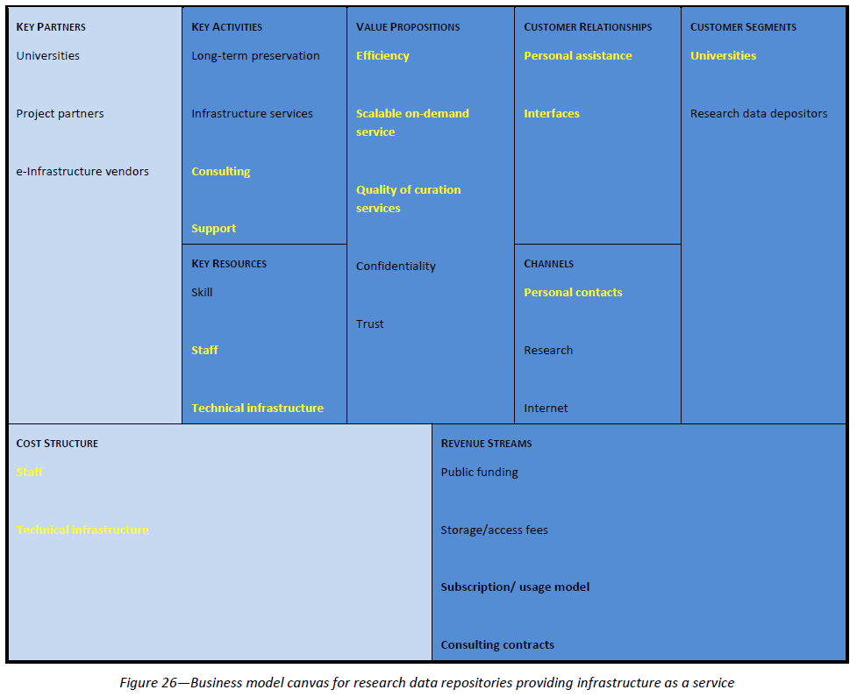
Revised BCM for Research Data Repository
Notes:
Delivering a service to new customers can require changes of key activities and resources as the new customers have different requirements for services or need additional services.
This example shows a research data repository that extended their services for universities.
The main motivation for the extension is to gain additional revenues by providing the available infrastructure and expertise to new customers. In this scenario universities are potential customers as they deal with large amounts of research data. Cost-efficient curation of the data without needing in-house expertise and services can be a good deal for the universities. The repository provides interface to their repository for uploading and accessing the university research data.
Support for the services is provided by the staff of the repository.
On top of this, the expert knowledge about managing research data is offered as a consulting service to the customers (universities) and complements the service offer. The research data repository is public funded, which established the required degree on trust in the long term availability of the curation services.
Universities are added as customer segment. The dominant communication channels are personal contacts between responsible persons of the universities and the archive. Assistance is provided by the repository to integrate the services into the existing infrastructure of the university. Interfaces are provided to allow members of the university to access the research data. In addition, on-site consulting can be offered for the integration and management of research data.
The value proposition of the business model canvas consists of efficiency and quality of the service and the trustworthiness of the organisation. A key motivation for the customers should be the cost saving by using the service from the repository. The service is offered as a scalable on-demand service. The customer has the advantage that only actual service usage is charged. This business case is intended for the medium and long term use. Therefore, the contracts are based on a subscription model combined with payment for usage. As the repository is publicly funded customers have a confidence and trust in the sustainability of the offered services.
Additional key activities are needed for the business, namely support and consulting services. The additional workload for the infrastructure and staff can require additional resources and increases the costs of the services. Additional storage and computation resources are needed to handle the data of the universities. The support and consulting service requires new staff resources. These changes are shown in key resources and cost structure of the business model canvases on the left side. The increase in resources can require additional key partners such as service providers for infrastructure.

Slide 16
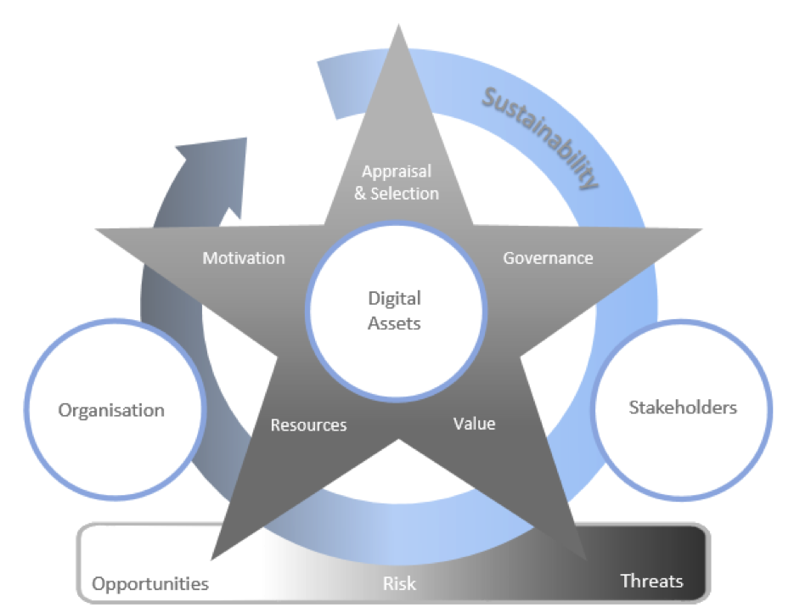
Digital Curation Sustainability Model
Notes:
In terms of longer sustainability, horizon scanning can help you to consider upcoming changes that may require an update to your business model.
The Digital Curation Sustainability Model (DCSM) offers a structured approach to identifying and thinking through the range of sustainability issues that are relevant to your organisation. To achieve this, the model builds on the key components of sustainability context, investment lifecycle, sustainability variables and risk management to recommend a structured questionnaire for self-assessment.
Perform a structured assessment
In practical terms, using the DCSM requires you firstly to design a questionnaire that covers the range of sustainability issues relevant to your organisation. Next, assess your organisation by completing this questionnaire in consultation with other stakeholders. Finally, use the results of your assessment to plan any actions necessary to achieve sustainability.
To assess your organisation:
-Evaluate the DCSM components to identify and summarise the sustainability issues relevant to your organisation.
-Work through the DCSM components and sample questions to design a customised self-assessment questionnaire.
-Assess your organisation by answering the questionnaire in consultation with all relevant stakeholders including external partner organisations where applicable.
Defining a single generic questionnaire that effectively represents practice and terminology across many different sectors is unrealistic. Sectors such as industry, memory institutions, education and government each have their own characteristics. To cope with this, the most effective use of DCSM requires you to customise the self-assessment questionnaire for your organisation.

Slide 17

Thanks – any questions?
DCC guidance, tools and case studies:
www.dcc.ac.uk/resources
Follow us on twitter:
@digitalcuration and #ukdcc

Slide 18
Now – it’s your turn
Select a specific RDM service that your group will flesh out.
    data management planning support
    implementing an institutional data repository
    setting up and maintaining a research data catalogue
    training for early career researchers and/or PhD students
Work through the sections of the BCM template. Think about
your own organisations and experiences.
Report back – each group will have 2-3 minutes to summarise
their discussions.
Notes:
For the next hour, you’ll work in your tables to work through a BCM template.

